Slide 1
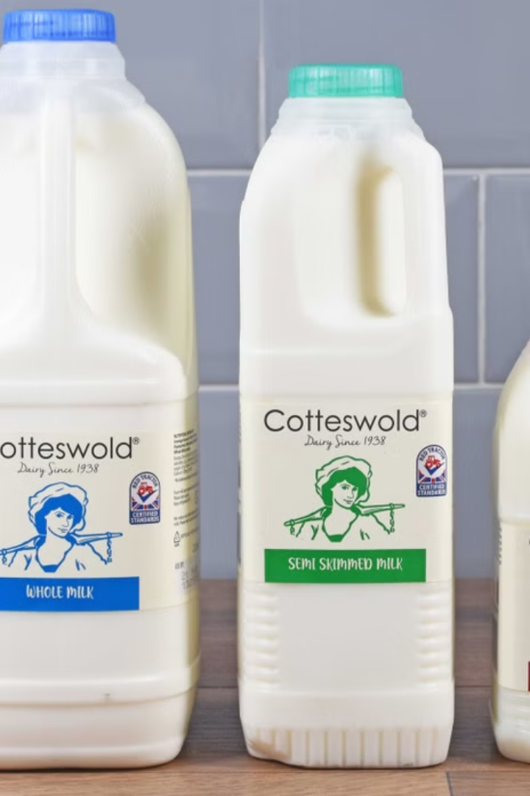

MILKCONNECT: E-Commerce for Dairy Products
Revolutionizing dairy shopping with fresh products delivered to your door. Built with MERN stack and EJS for dynamic, efficient e-commerce.
Connecting consumers directly with their local farms for quality and trust.
by KARAN MITTAL

Slide 2
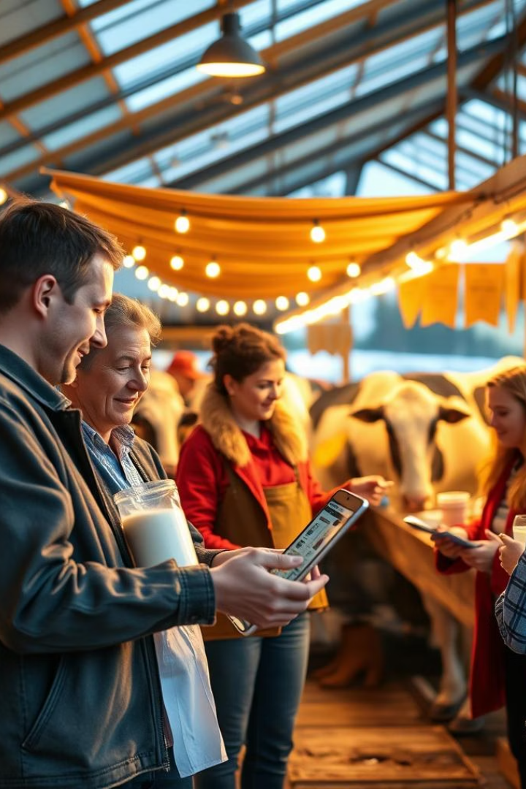
The Vision: Bridging Farms & Consumers
Problem
Solution
Inefficient traditional dairy distribution limits freshness and transparency.
MILKCONNECT offers a direct-to-consumer platform ensuring fresh dairy deliveries.
Target Market
Health-conscious buyers and supporters of local farmers.

Slide 3
Key Features: A Seamless Dairy Experience
Online ordering and delivery scheduling
Customer reviews and product ratings
Secure payments via Stripe and PayPal
User-friendly interface with responsive design
Real-time order tracking and notifications
Farm-to-door freshness guarantee

Slide 4





Tech Stack: MERN (minus React) + EJS
MongoDB
Scalable document database for all product and user data
Express.js
Robust backend framework managing APIs and logic
EJS
Dynamic templating engine replacing React for simpler development
Node.js
Efficient runtime enabling fast server-side operations

Slide 5
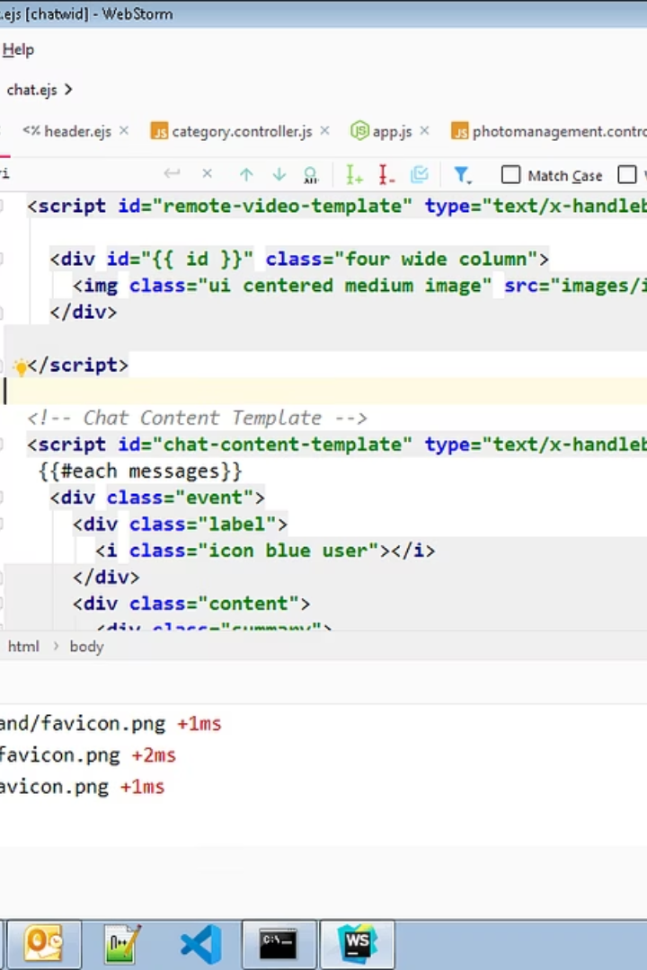

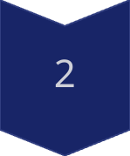
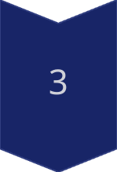
EJS in Detail: A Lightweight Alternative
Dynamic Content
EJS generates HTML dynamically on the server side.
Server-side Rendering
Improves SEO and reduces initial load time.
Example Usage
Displays product details and prices dynamically for each user.

Slide 6
MILKCONNECT Architecture
Client-side
Server-side
Database
Templates
HTML, CSS, and JavaScript render the user interface in the browser.
Node.js and Express manage APIs and business logic on the backend.
MongoDB stores all product info and user data securely.
EJS dynamically generates HTML pages on the server for fast delivery.

Slide 7
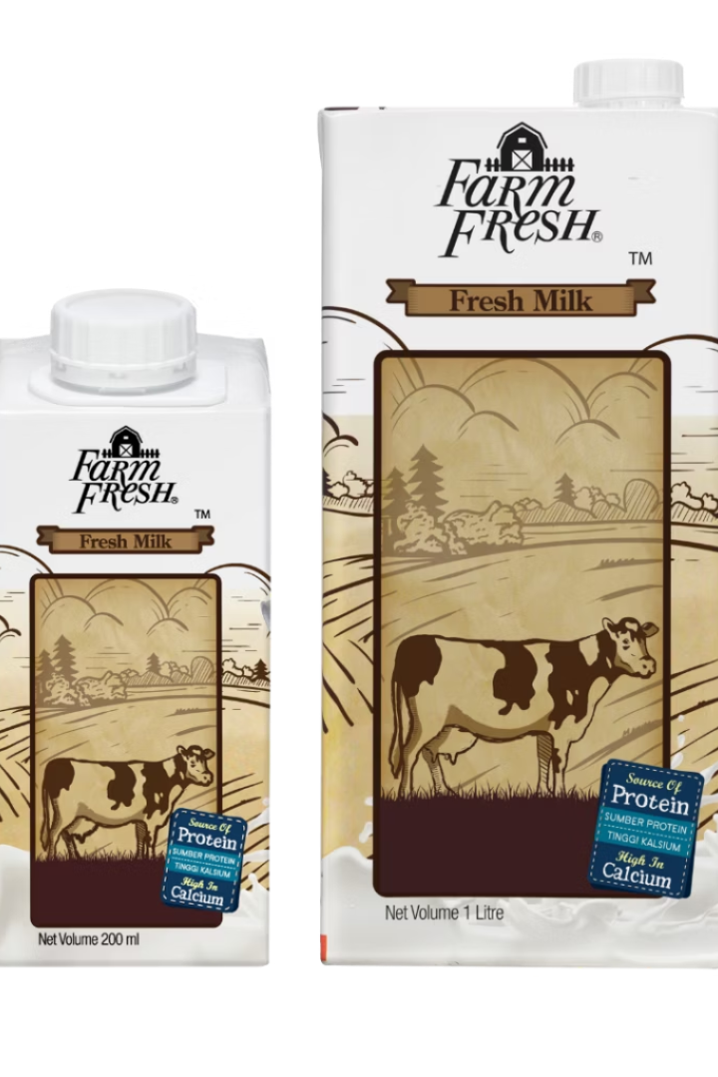




Unique Value Proposition
Farm-to-Table Freshness
Support Local Farmers
Transparency
Traceability from farm origin to your doorstep.
Dairy delivered within hours for unmatched quality.
Empowering small businesses and local communities.
Convenience
Easy online ordering with flexible delivery options.

Slide 8

Monetization Strategy
1
Commission on Sales
Earn a percentage from each transaction on the platform.
2
Premium Farmer Listings
Paid enhancements for better product visibility.
3
Targeted Advertising
Ads focused on dairy-related products and services.
4
Subscription Model
Recurring revenue through customer loyalty plans.

Slide 9
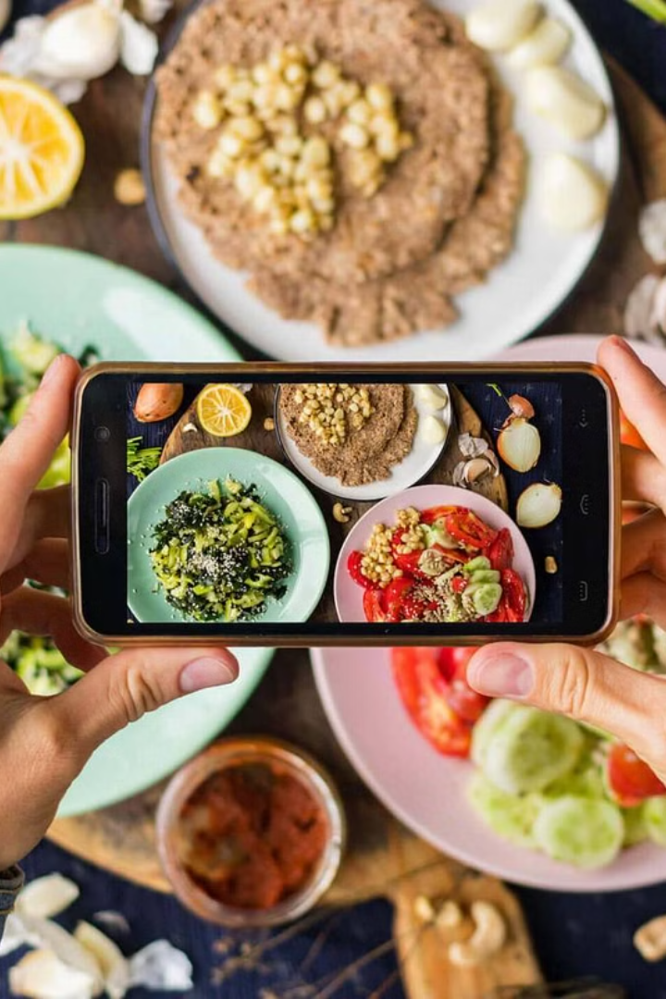
Marketing and Growth Strategy
Social Media Marketing
Targeted ads and collaborations with influencers.
Content Marketing
Sharing recipes, health benefits, and farm stories.
Local Partnerships
Cross-promotions with nearby businesses and events.
SEO Optimization
Boost organic traffic with improved search rankings.

Slide 10
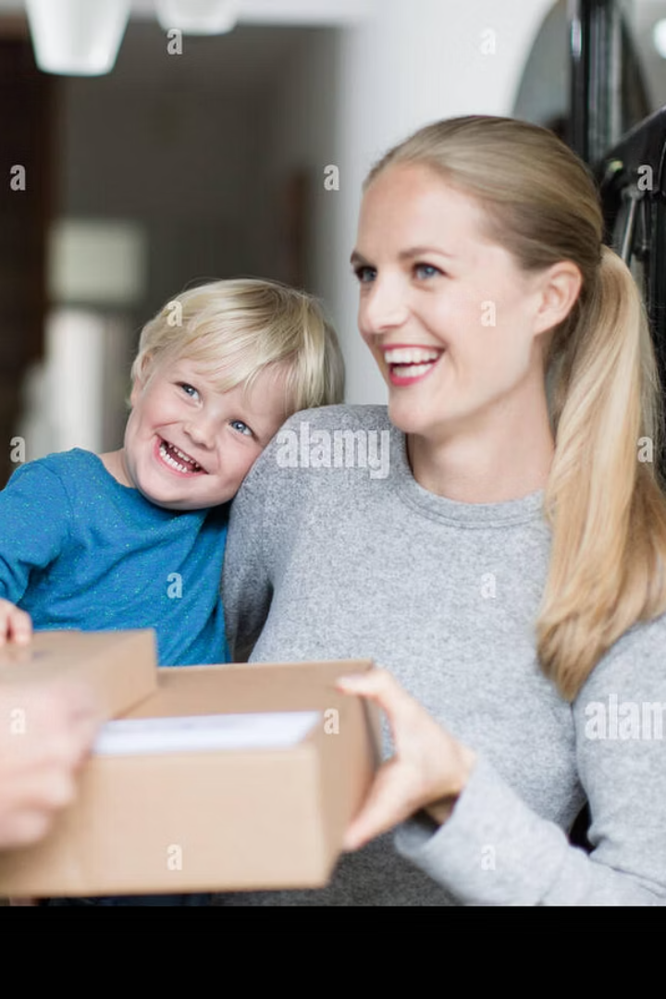
Conclusion: The Future of Dairy E-Commerce
MILKCONNECT is redefining dairy shopping with freshness and local support.
Our model is scalable, sustainable, and community-driven.
Join us to build a healthier, connected dairy future.

